Slide 1


Python primer
Mining the social web with python

Slide 2
Goals for todays talk
Hint at the elegance of the python programming language
Show how python can be used to “easily” mine social media data
Using data types you will learn about today!
Introduce some interesting python libraries
“Someone has already done that!”
A tweet is much more than 140 characters!

Slide 3

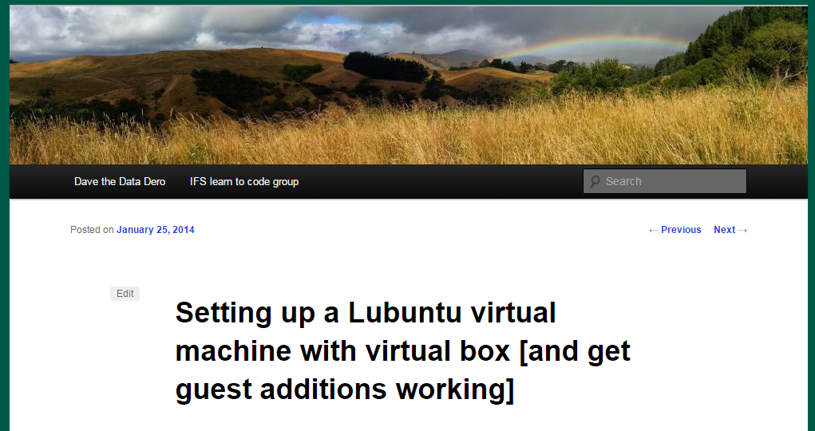
Tools and libraries
If you take home only one thing the Research Bazar, make it Linux (and tell ITS about it)!
https://dwheelerau.com/2014/01/25/setting-up-a-lubuntu-virtual-machine-with-virtual-box/

Slide 4
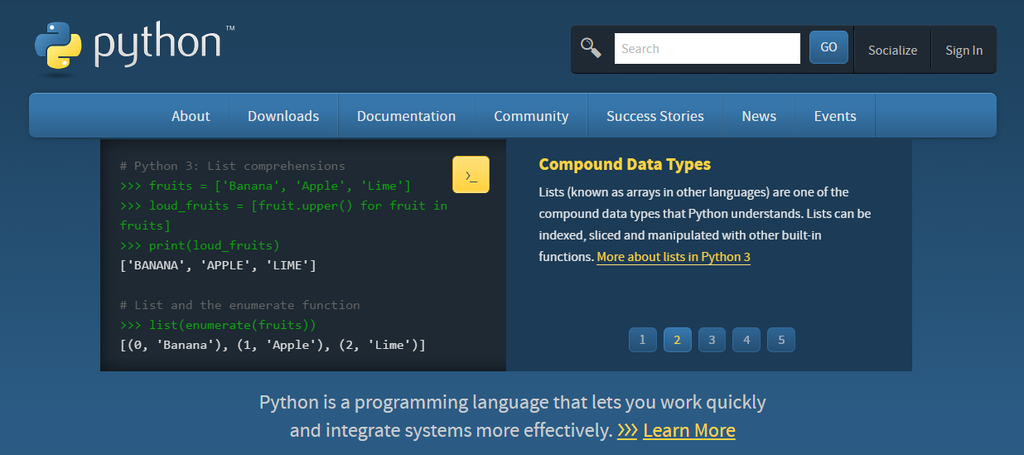
Tools and libraries
https://www.python.org/

Slide 5
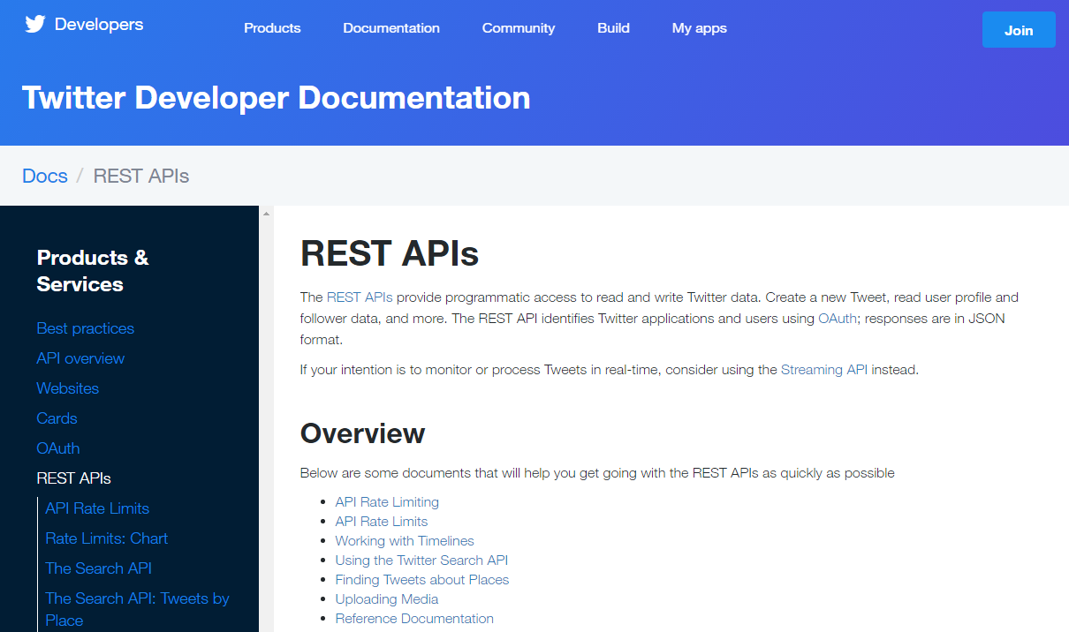
Tools and libraries
https://github.com/bear/python-twitter
https://dev.twitter.com/rest/public

Slide 6
The python twitter library
The python twitter library is just a wrapper for web (http) requests based on the REST philosophy
Returns data in nested python lists and dictionaries
You will be using some of these data types today

Slide 7
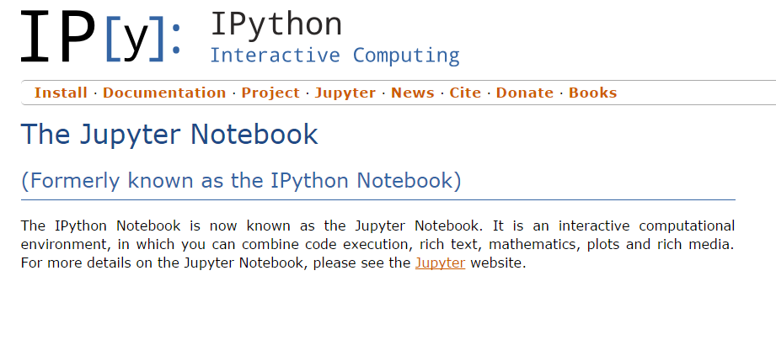
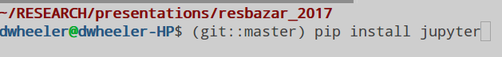
Tools and libraries
https://ipython.org/notebook.html

Slide 8
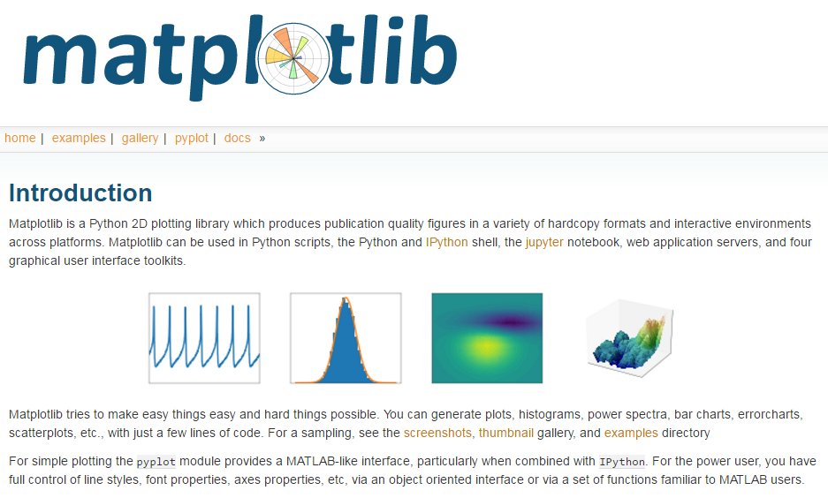
Tools and libraries
http://matplotlib.org/

Slide 9
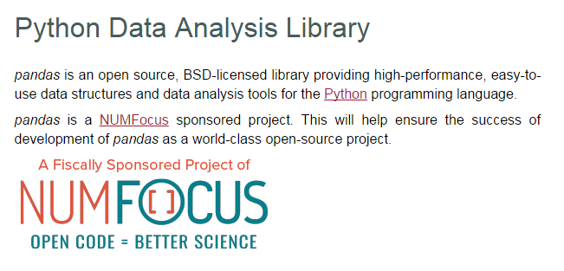
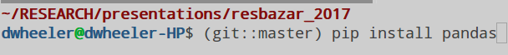
Tools and libraries
http://pandas.pydata.org/

Slide 10

Tools and libraries
http://shop.oreilly.com/product/0636920030195.do

Slide 11
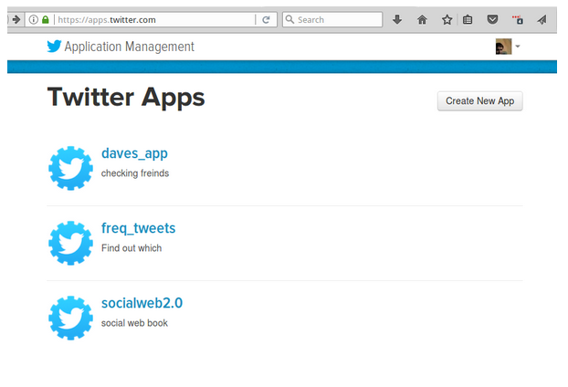
Getting access to the twitter API
https://apps.twitter.com/

Slide 12
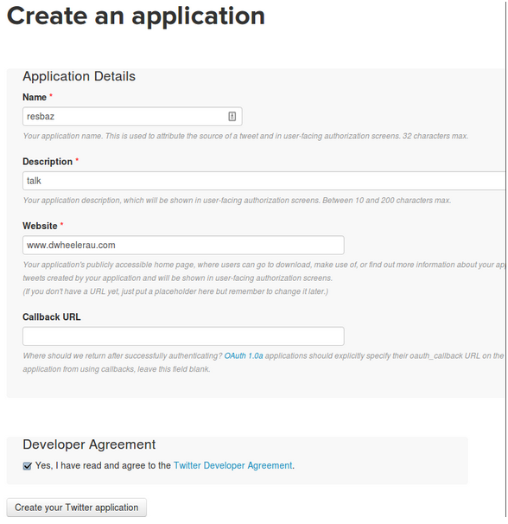
Getting access to the twitter API

Slide 13
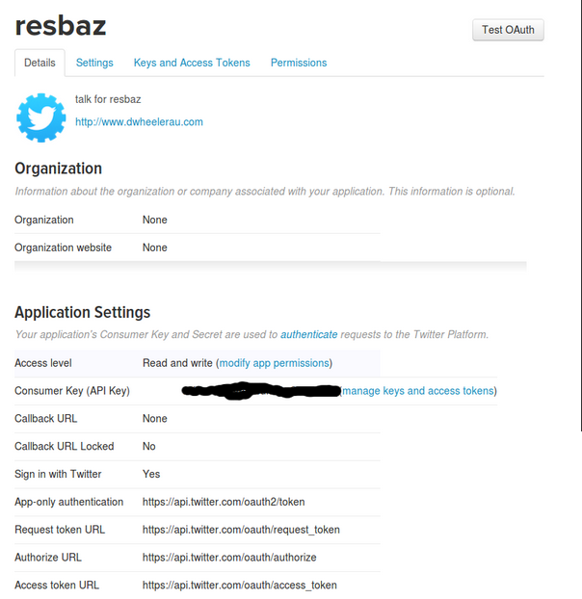
Getting access to the twitter API

Slide 14
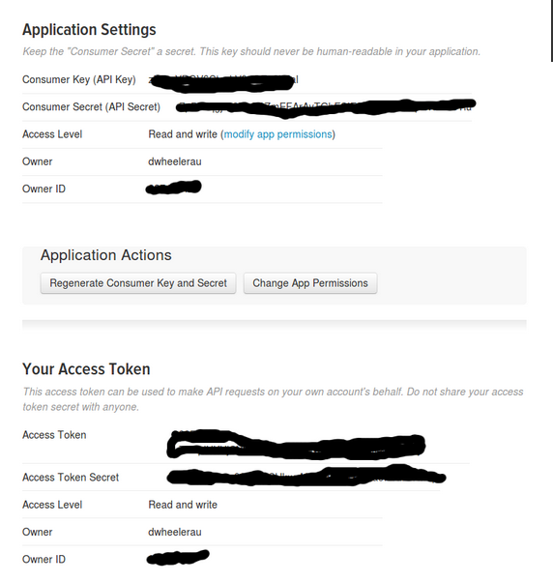
Getting access to the twitter API
You need the consumer Key, Consumer Secret, Access token and Access Token secret

Slide 15
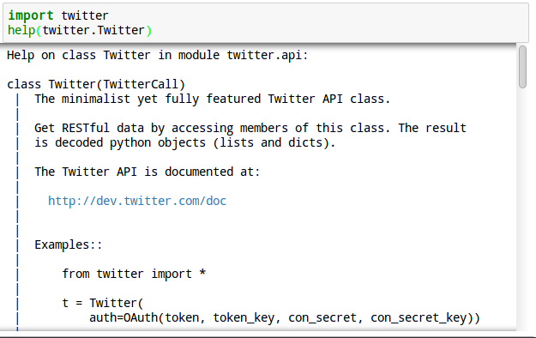
The python Twitter library
Notes:
Get information through http requests

Slide 16
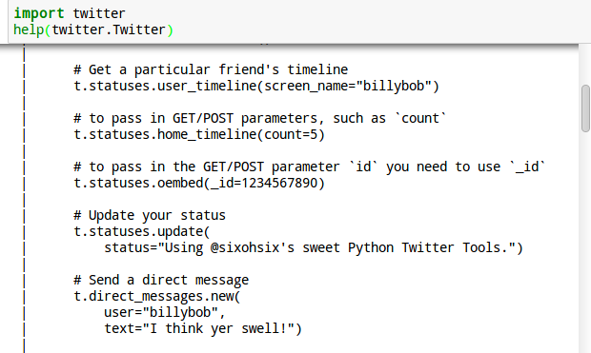
The python Twitter library

Slide 17
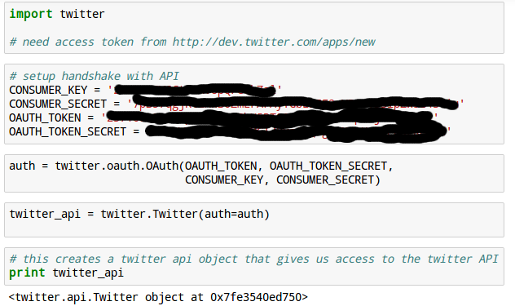
Python twitter

Slide 18
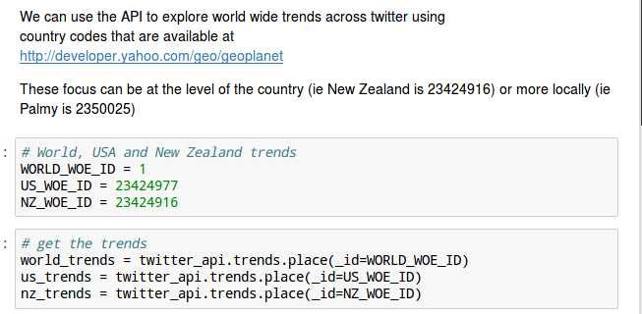
Twitter trends
Need GEO codes that we can get from http://developer.yahoo.com/geo/geoplanet
Notes:
Palmy is 2350025

Slide 19
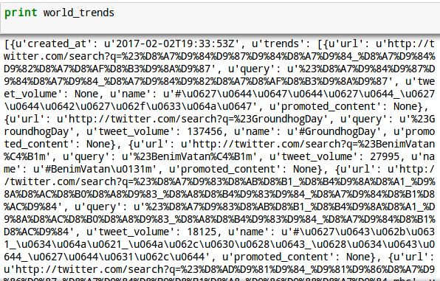
Twitter trends
Returns data as nested python lists and python dictionaries

Slide 20
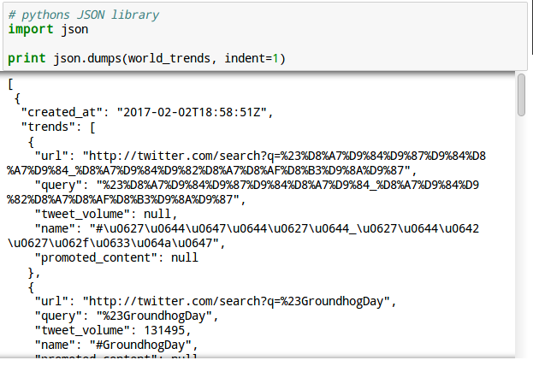
Twitter trends

Slide 21
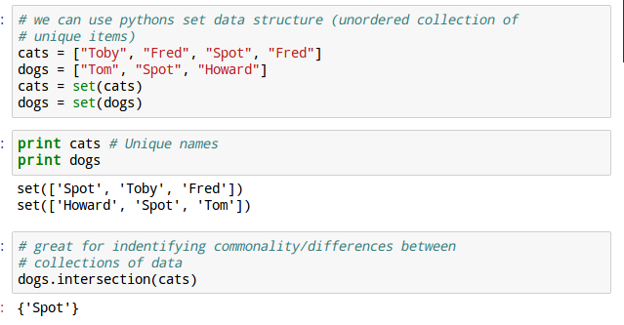
Geographical twitter trends

Slide 22
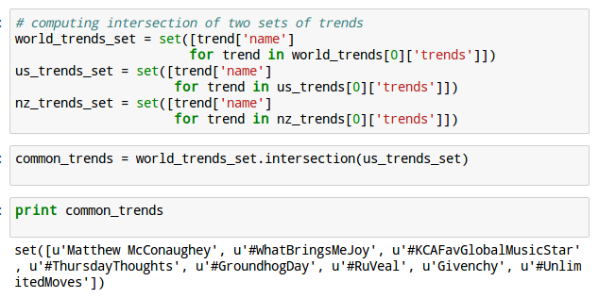
Geographical twitter trends

Slide 23
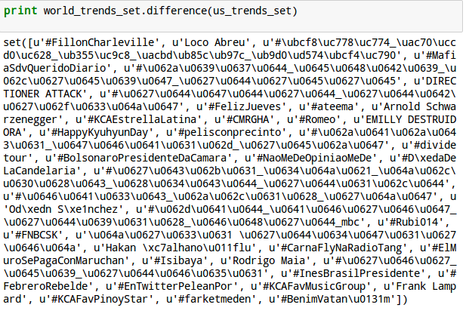
Geographical twitter trends

Slide 24
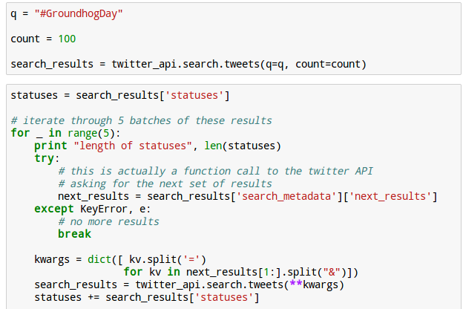
Twitter trends

Slide 25
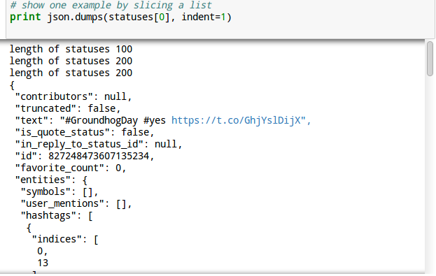
Twitter trends

Slide 26
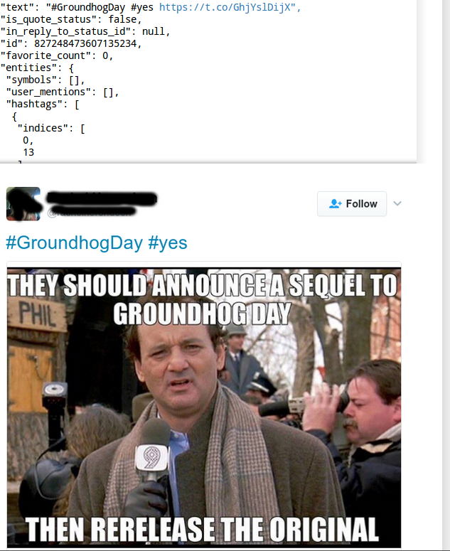

Slide 27
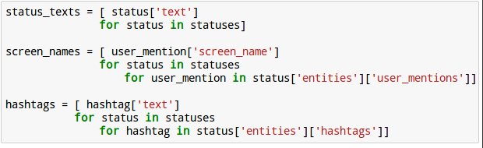
Twitter trends
000

Slide 28
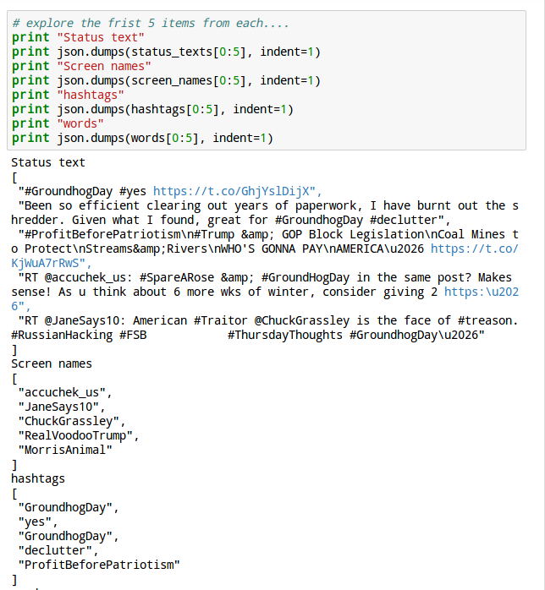
Twitter trends
Search for “#GroundhogDay”
Status text
Screen names
Hashtags

Slide 29
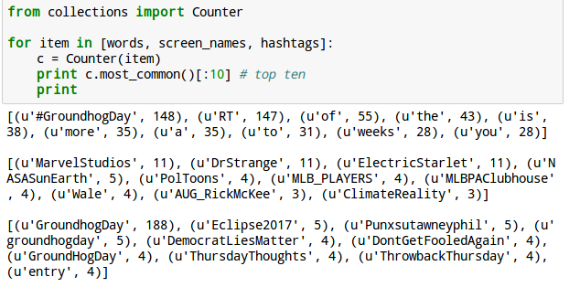
Twitter trends

Slide 30
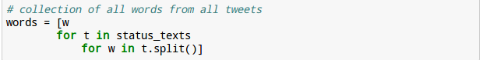
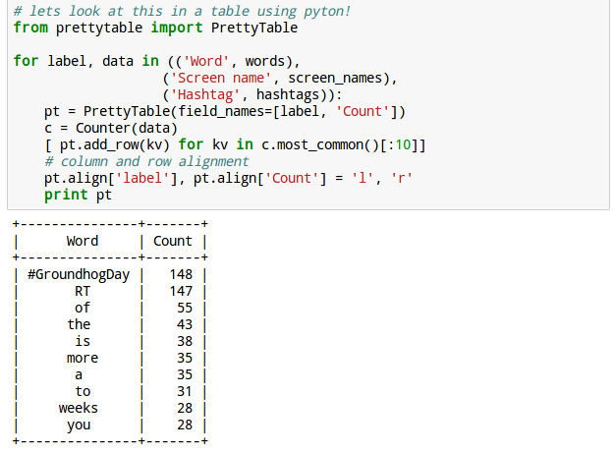
Twitter trends

Slide 31
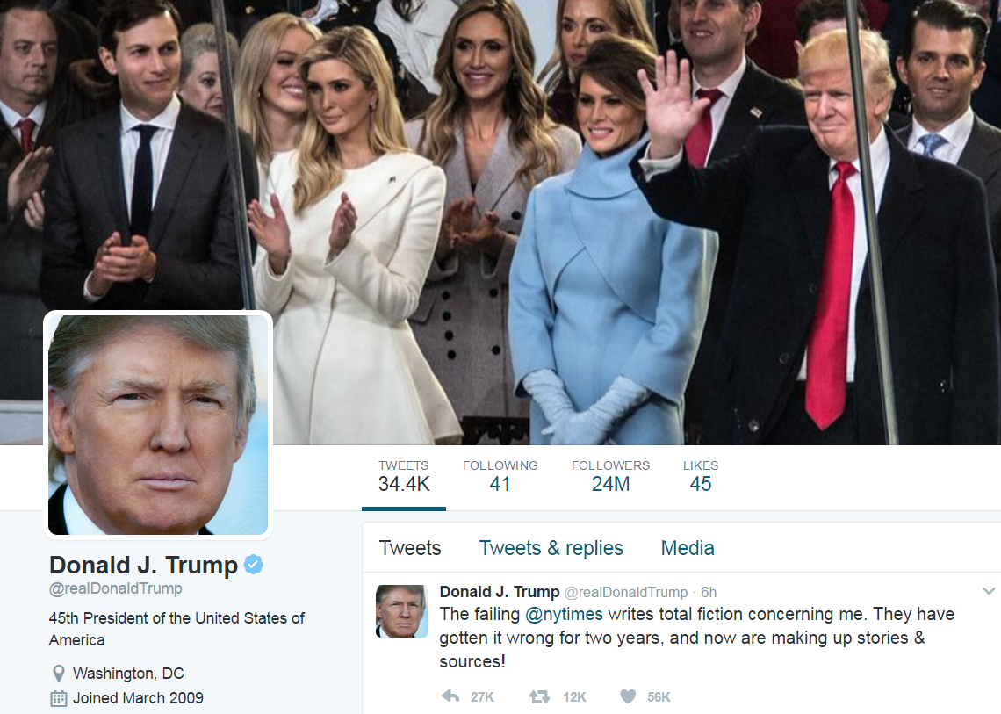
The tweets of @realDonaldTrump

Slide 32
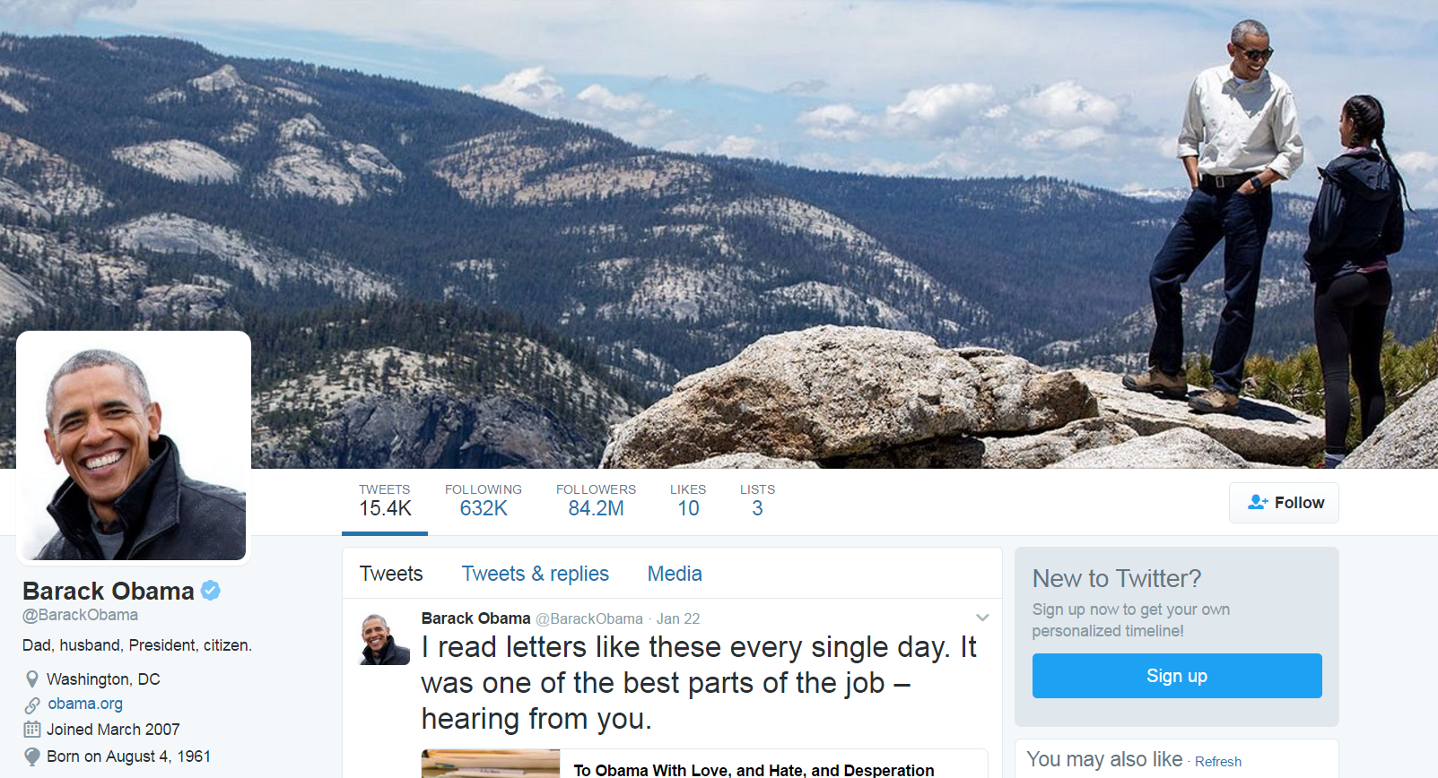
…and @BarackObama

Slide 33
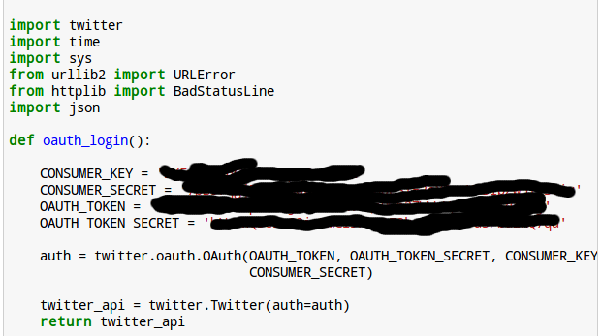
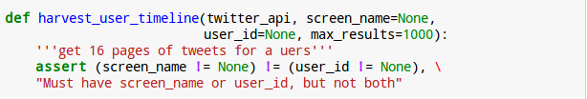
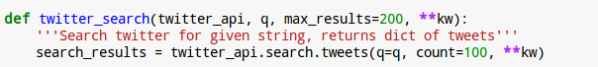
Writing some helper functions
Create twitter object
Collect user tweets
Search for tweets

Slide 34
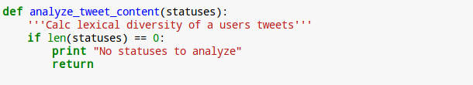
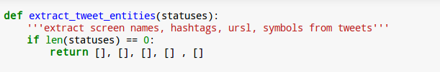
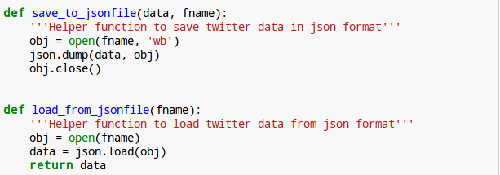
Writing some helper functions
Lexical diversity
Extract tweet info
Save/load info
In JSON format

Slide 35
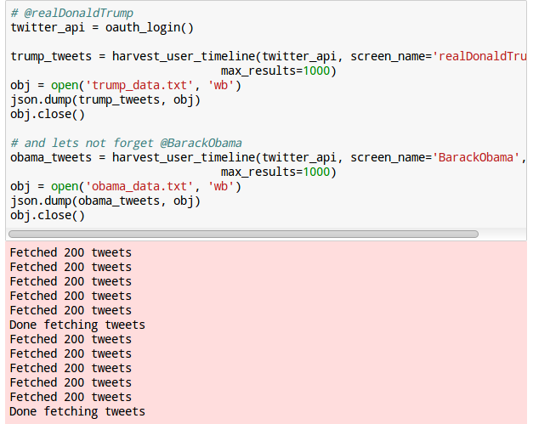
Presidential tweets

Slide 36
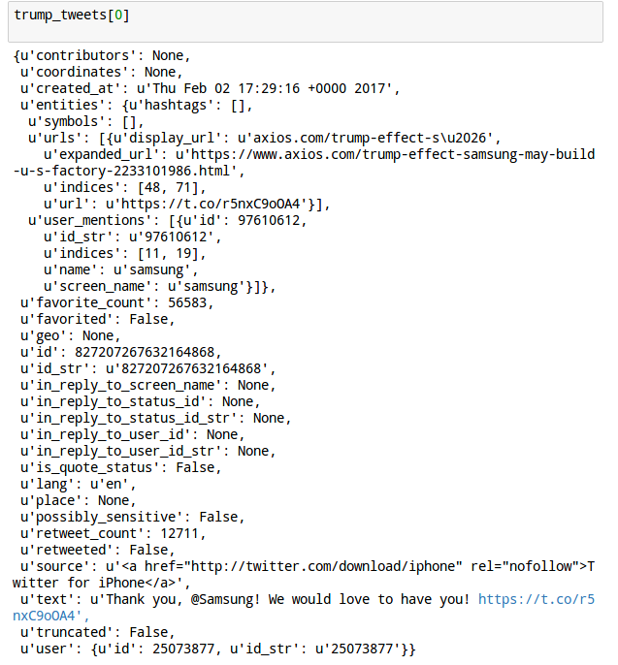
Presidential tweets

Slide 37
Lexical diversity
Number of unique “words” in text divided by total number of words
Or the “unique information” gained from each tweet
The function “analyze_tweet_content” calculates this by:
Count the number of words
Use “set()” to count the number of unique words
A lexical diversity of 0.25 would equate to around ¼ words are unique within aggregated tweets (about 3 words in an average 14 word tweet)

Slide 38
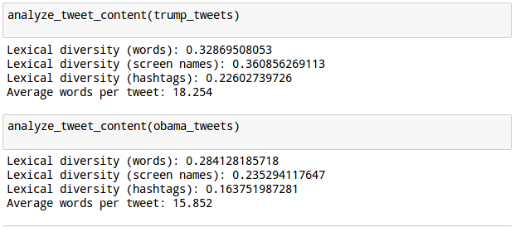
Lexical diversity
Trump is a winner (alternative facts?)
Notes:
les

Slide 39
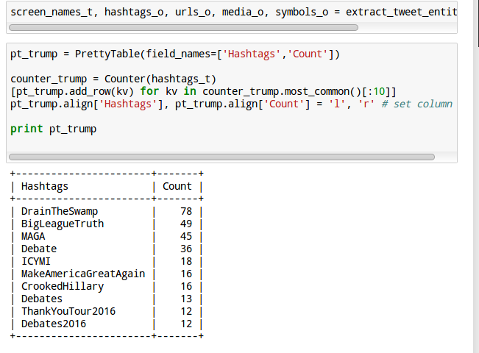
Presidential tweets

Slide 40
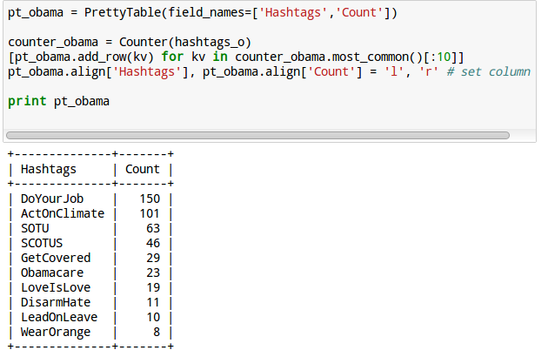
Presidential tweets

Slide 41
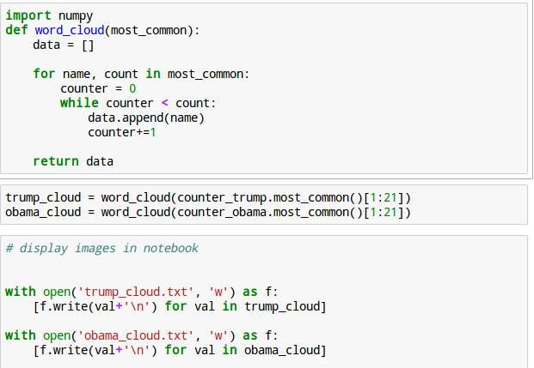
Presidential tweets

Slide 42
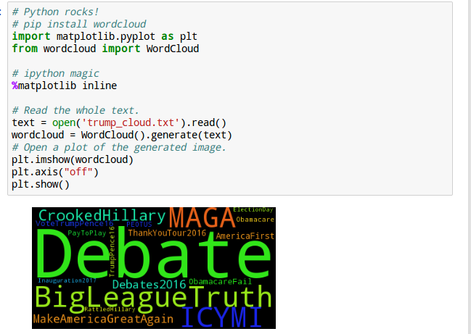
Presidential tweets

Slide 43
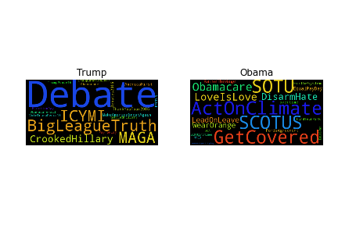
Presidential tweets

Slide 44
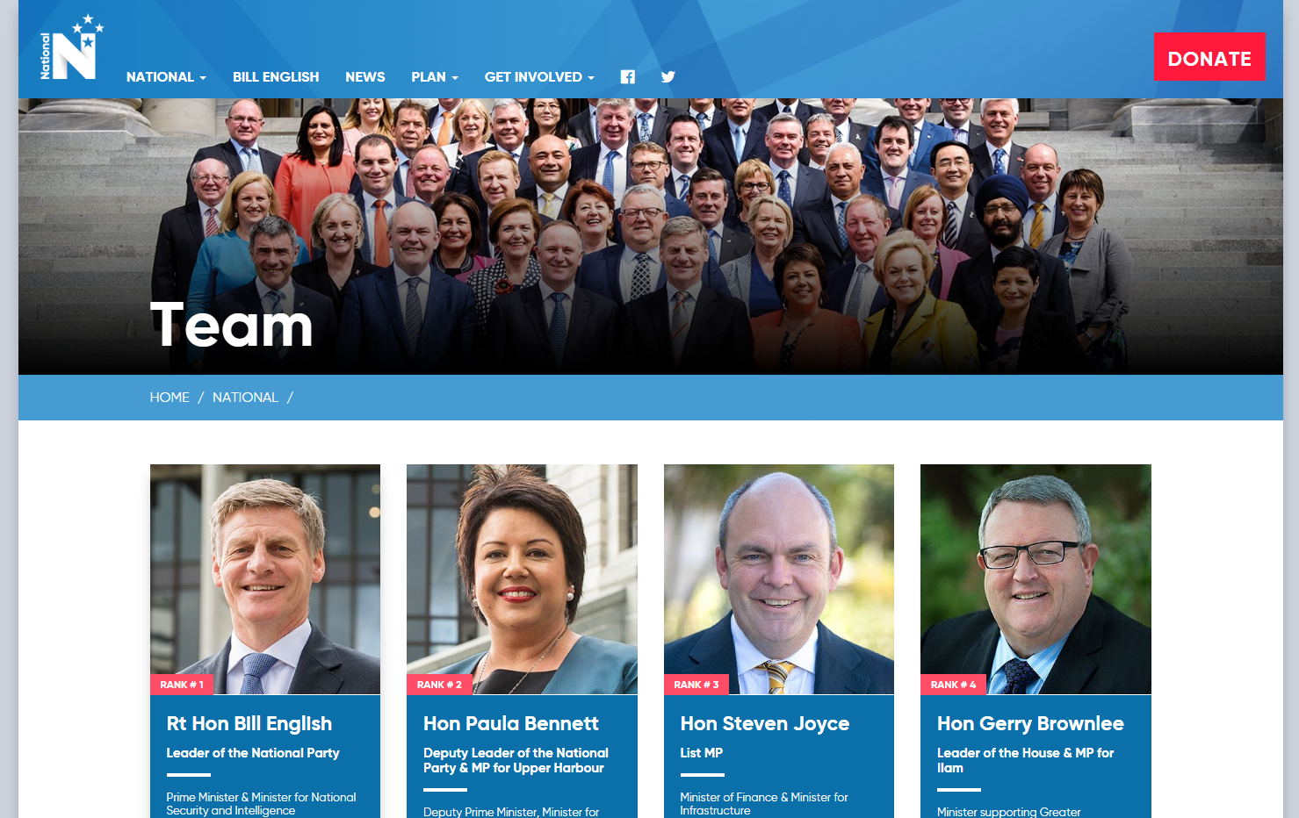
What about NZ?
https://www.national.org.nz/team

Slide 45
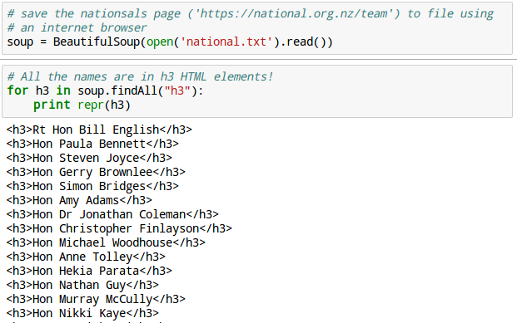
An aside: Beautifulsoup

Slide 46
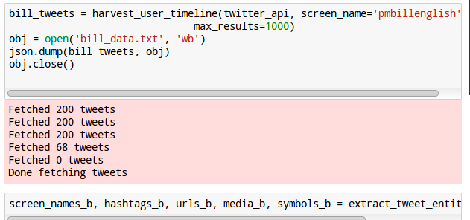
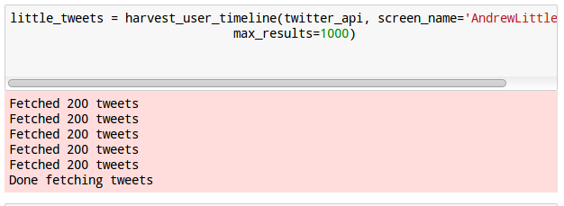
What about NZ?

Slide 47
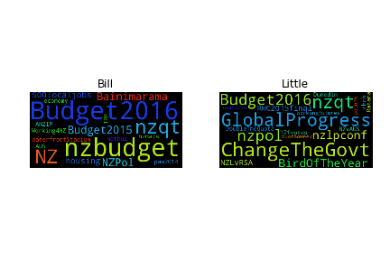
What about NZ?

Slide 48

Leave the pollies alone @dwheelerau

Slide 49

Leave the pollies alone @dwheelerau

Slide 50

Where do my followers live?

Slide 51

How often do I tweet?

Slide 52

How often do I tweet?
Processing tabular data with pandas

Slide 53

How often do I tweet?

Slide 54

This is only the start
Finding patterns in tweets and re-tweets
Use “Australia” as a search term (back to Trump)
Nodes represent usernames and edges represent a re-tweet relationship
Use HTML5 magic to display interactively

Slide 55

This is only the start

Slide 56


Slide 57
Thank you for your time
Thanks to the open source community that make this all possible!
Clone this talk @github (https://github.com/dwheelerau/ResBazPub.git)
Follow me on twitter (@dwheelerau)
Bioinformatics and data science blog (www.dwheelerau.com)
Rm D5.31 IFS, Massey University

